Slide 1
Unsupervised Machine Learning Clustering Model
Data Set: Health Insurance Cross to Sell Prediction, identifying segmentation
Link to watch the presentation
https://montclair.zoom.us/rec/share/vpsc5sysqqOhybzQgE6h3vk7NbaRTA70NLVPSYqQ5cyf32DJpC_Wu4kinenS1jcn.rOvAHRy2q5TdnsLJ?startTime=1698005203000
Passcode: U%F87rM@
Mariana Tapieros Arias
MSBA Student - Big Data

Slide 2
Problem: Identification of distinct customer segments, to development of targeted marketing and sales strategies.
Company
Context
Problem statement
Our client is an Insurance company that has provided Health Insurance to its customers and is interesting to offer a Vehicle insurance to its current customer
An insurance policy is an arrangement by which a company undertakes to provide a guarantee of compensation for specified loss, damage, illness, or death in return for the payment of a specified premium. A premium is a sum of money that the customer needs to pay regularly to an insurance company for this guarantee.
identify different segments to be able to predict in the future whether the policyholders (customers) from past year will also be interested in Vehicle Insurance provided by the company.
Reference: Kaggle https://www.kaggle.com/datasets/anmolkumar/health-insurance-cross-sell-prediction/data?select=train.csv

Slide 3
Challenges deep-dive
Computational Resources
Data Preprocessing
Evaluation and Validation
Bias and Fairness
Applying clustering algorithms to big data requires substantial computational resources, including memory and processing power. Distributed computing and parallelization techniques may be needed to complete the analysis.
Data cleaning, preprocessing, and feature engineering are critical but time-consuming steps. Handling missing data, outliers, and ensuring data quality can be more challenging.
Assessing the quality and validity of clustering results can be challenging. Traditional validation metrics may not be suitable for it.
Big data can sometimes contain biases that are reflected in clustering results. Addressing bias and ensuring fairness in clustering is an emerging challenge, especially when working with large and diverse datasets.

Slide 4
Solution
Scope: Our objective is to construct an unsupervised machine learning clustering model designed to segment our dataset effectively.
Define Segmentation

Slide 5
Implementation

Slide 6
Get access to the data set. Read and Understand our data set.
PipeLine data; Imputation, Standardization, Dummies to ensure fair comparisons during clustering.
Share findings.
10.13.23
10.15.23
10.17.23
10.20.23
10.22.23
Data pre processing: Conducted data preparation, ensuring data quality and addressing missing values, outliers, and irrelevant features.
Employed a suitable clustering algorithm K-Means. Analyzed and interpreted the clusters, assigning meaningful labels.

Slide 7
Get access to the data set.
Variable | Definition | Type
Id | Unique ID for the customer | Numeric
Gender | Gender of the customer Female and Male | String - Categorical
Age | Age of the customer | Numeric - Continues
Driving License | 0: Does not have driver licence, 1: has driver licence | Will be treated as String - Binary since it represent 1 yes, 0 No
Region Code | Unique code for the region of the customer | Will be treated as String - To get dummies
Previously Insured | 1: Customer already has Vehicle Insurance, 0 : Customer doesn't have Vehicle Insurance | Will be treated as String - Binary since it represent 1 yes, 0 No
Vehicle_Age | < 1 year, 1-2 year, >2 years | String - Categorical
Vehicle_Damage | Yes / No | String - Categorical
Annual_Premium | The amount customer needs to pay as premium in the year. | Numeric - Continues
Policy_Sales_Channel | Anonymized Code for the channel of outreaching to the customer ie. Different Agents, Over Mail, Over Phone, In Person, etc. | Will be treated as String since it represent categories.
Vintage | Number of Days, Customer has been associated with the company | Numeric - Continues
Response | 1 : Customer is interested, 0 : Customer is not interested | Will be treated as String - Binary since it represent 1 yes, 0 No
Data Set Resource: https://www.kaggle.com/datasets/anmolkumar/health-insurance-cross-sell-prediction/data?select=train.csv
Data Set Size: 12 columns
381.109 rows

Slide 8
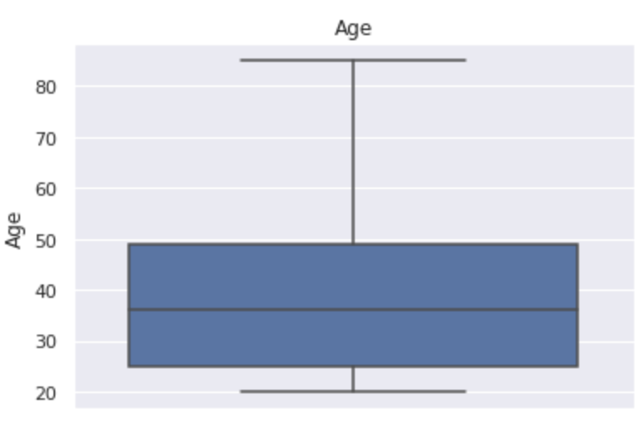
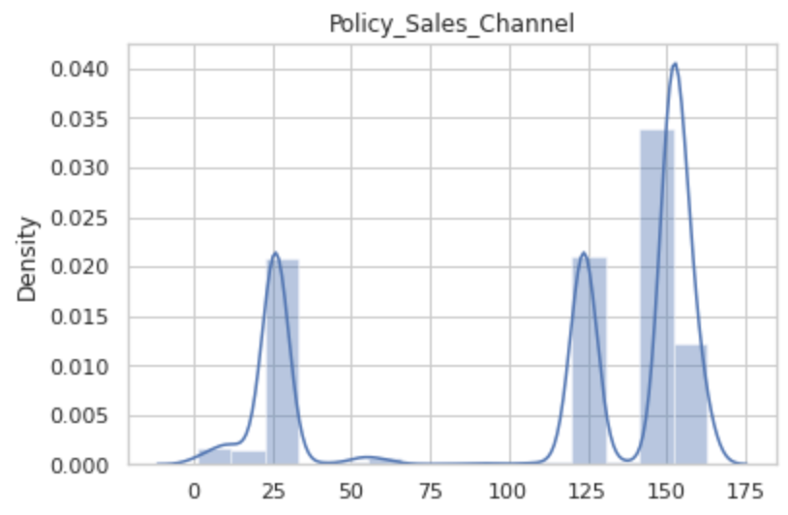
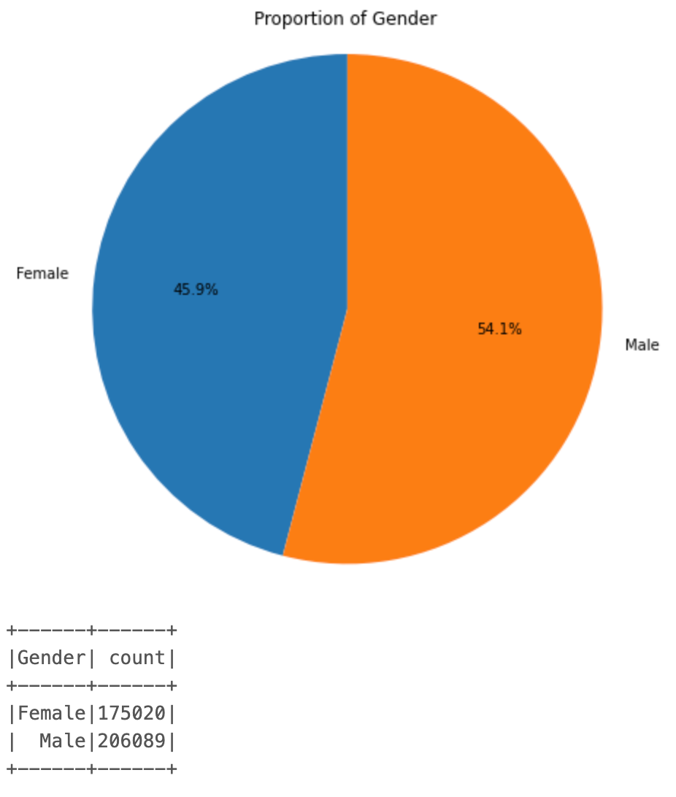
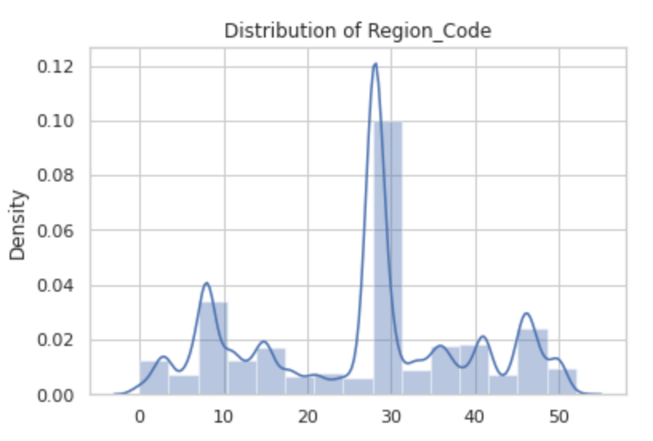
Read and Understand our data set.

Slide 9
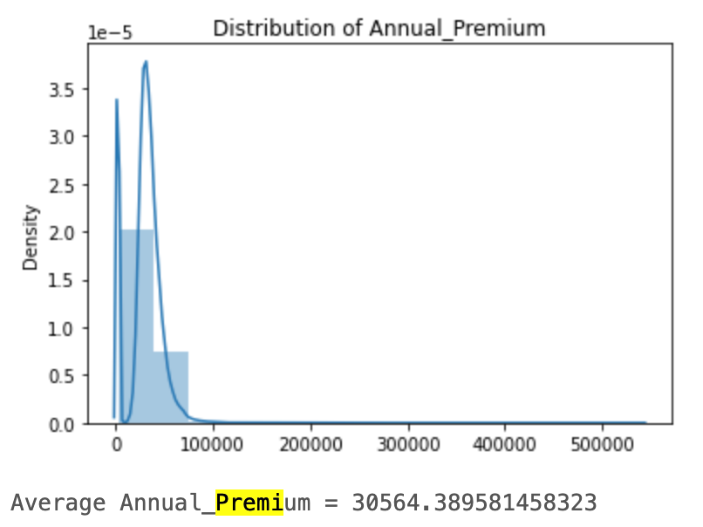
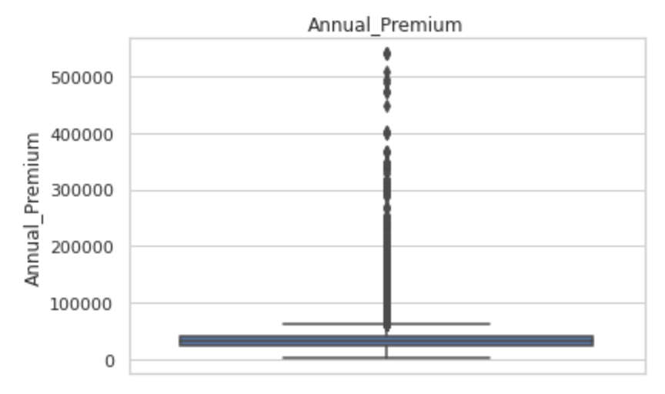
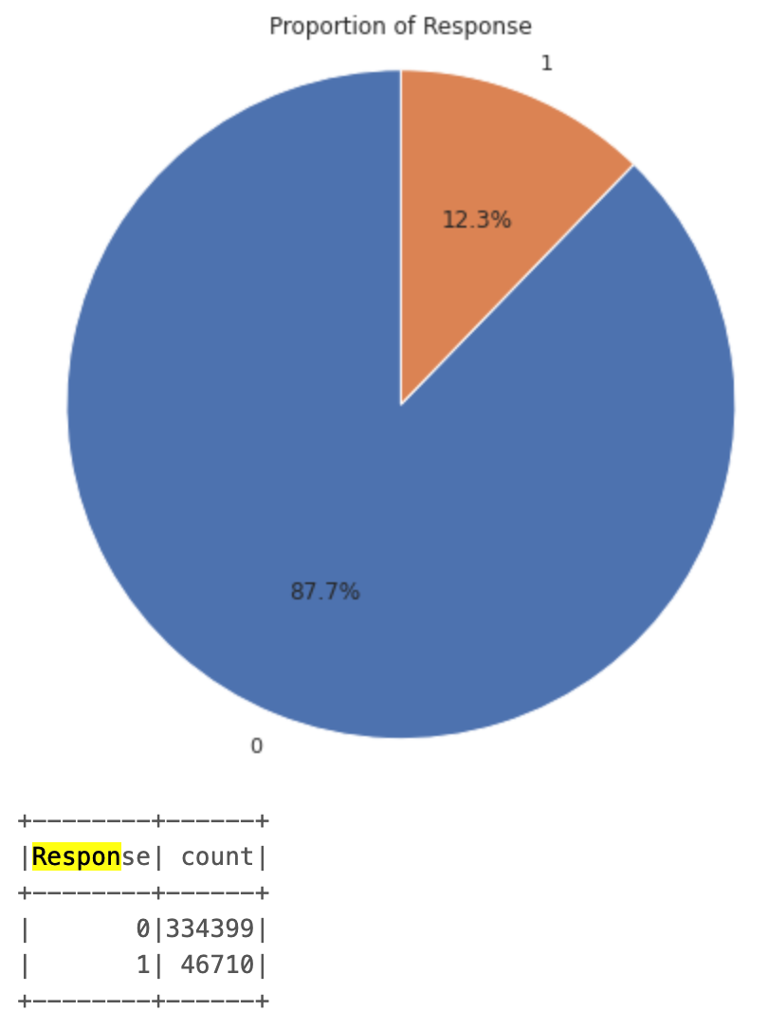
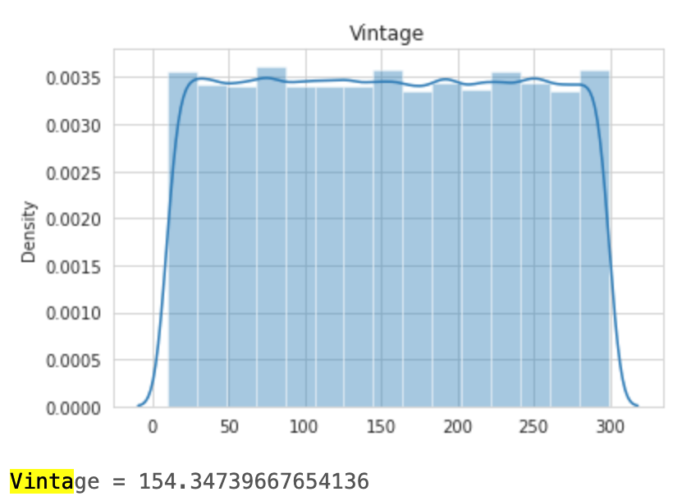
Read and Understand our data set.
25% of the data is represent for the outliers in this variables-Annual Premium

Slide 10
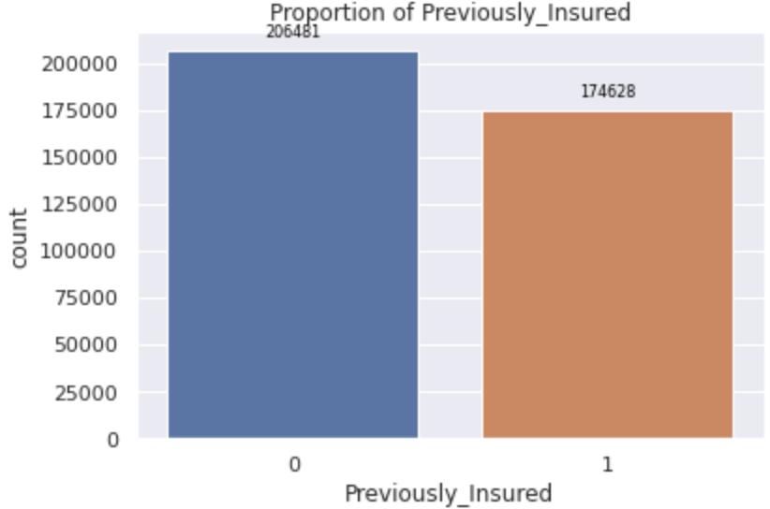
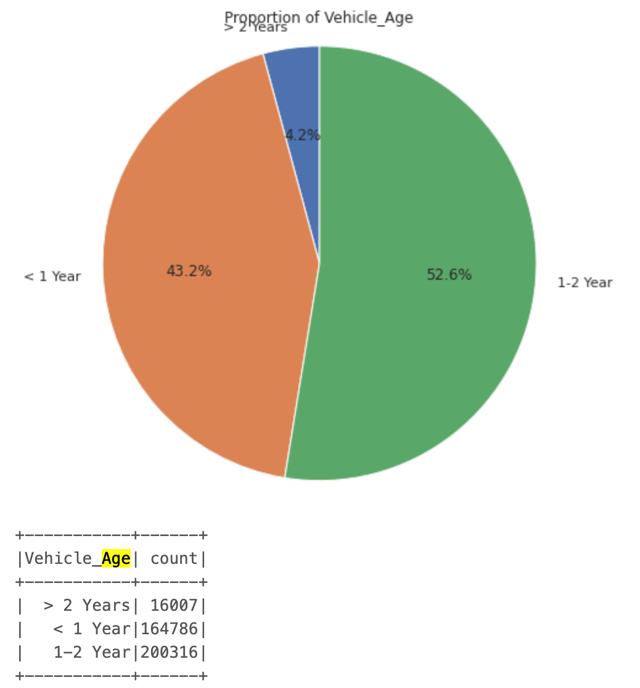
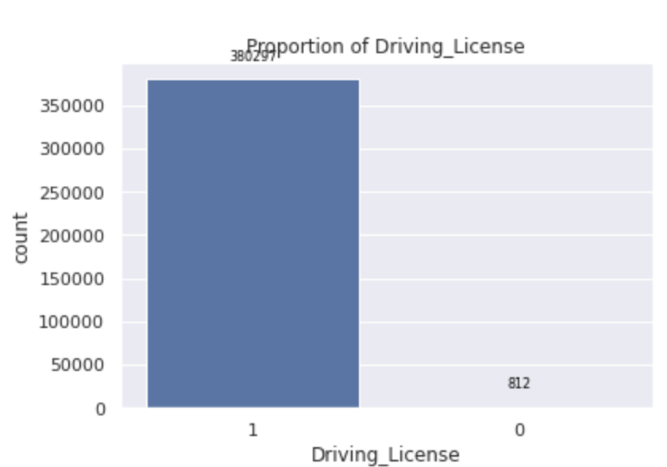
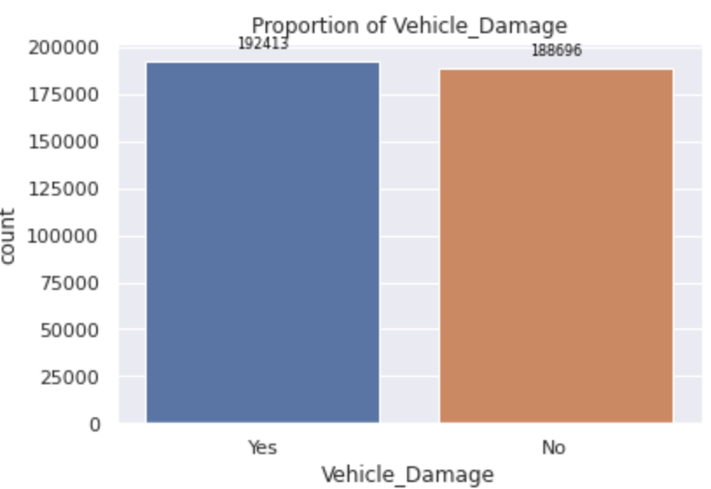
Read and Understand our data set.

Slide 11
Data Pre Processing
1
2
3
4
Create SQL Context to read the data
Check to Drop Empty Columns and Irrelevants features
Identify Null Values for Imputation
Identify Categorical and Numerical Variables

Slide 12
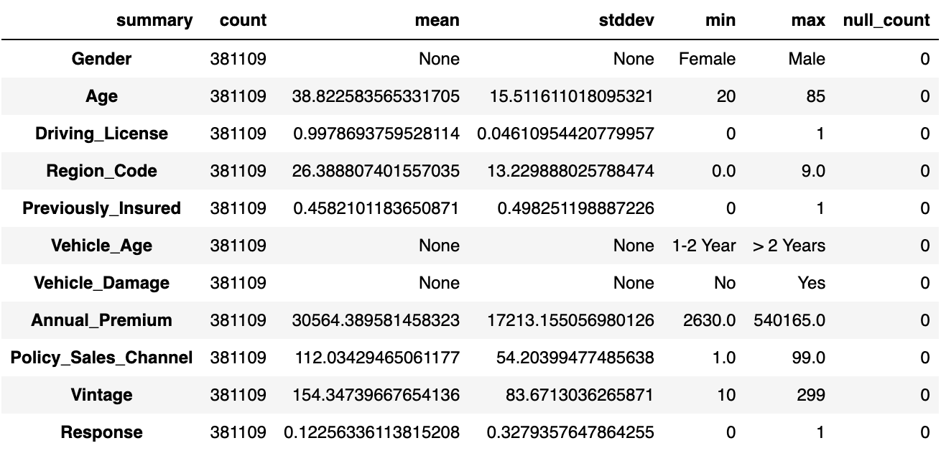
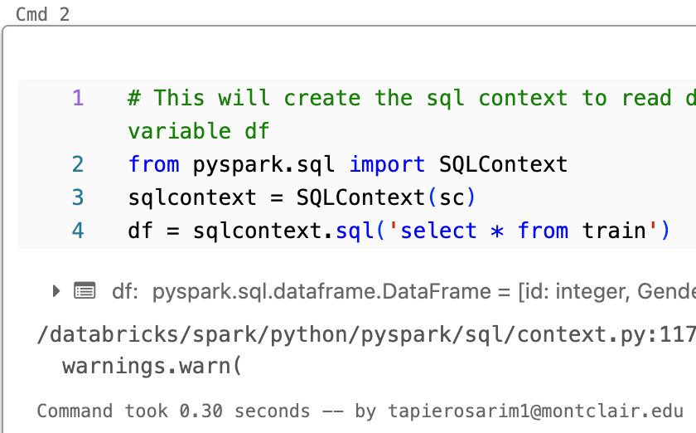
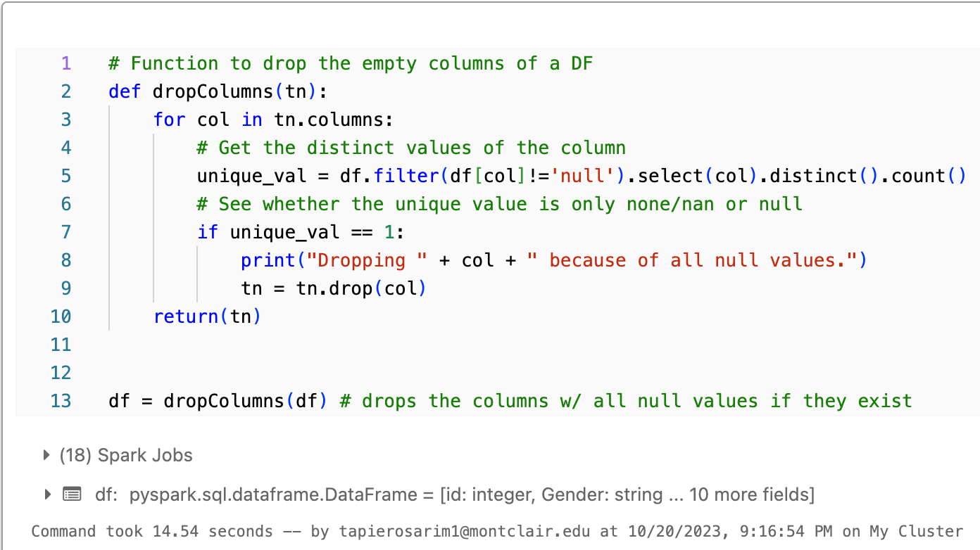
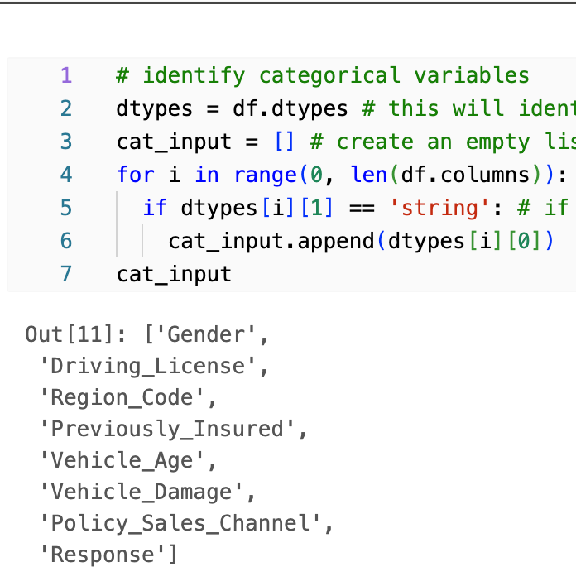
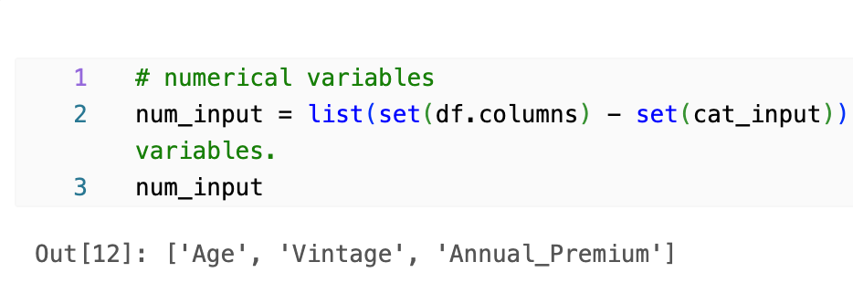
Data Pre Processing

Slide 13
Data PipeLine
Numerical and Categorical Impute
Mean - Quantile 50%
Mode
05
Add Stages to the PipeLine
Concatenates all input variables and name them as features.
Add the numerical and categorical imputation, standardization and encoder to the PipeLine
01
04
Determinate Variable
Choose the columns –variable that are going to be transformed and used to run the model they are going to be just renamed.
Standardization
rescale the features of a dataset to have a mean of 0 and a standard deviation of 1
02
03
Indexer and Encoder Categorical Variables
Indexing is used when there's an ordinal relationship among categories or ordinal values.
Encoding is employed to convert categorical variables that only have two labels 0-1.

Slide 14
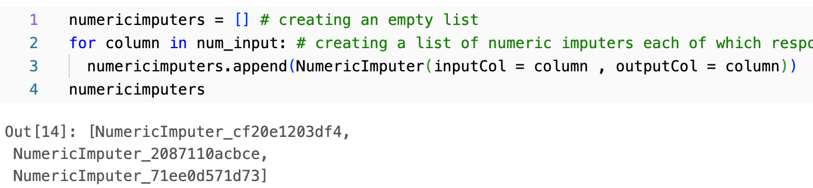
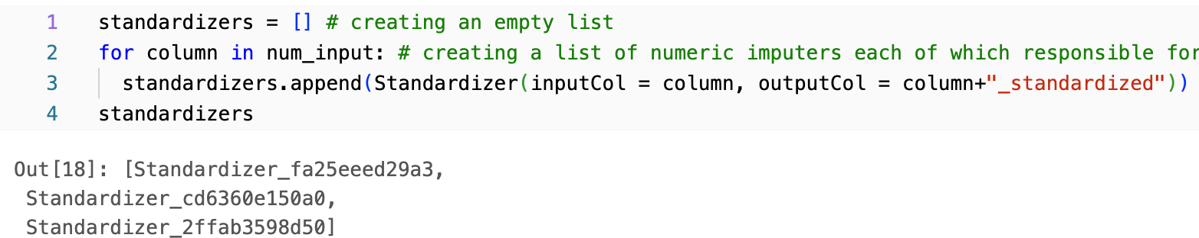
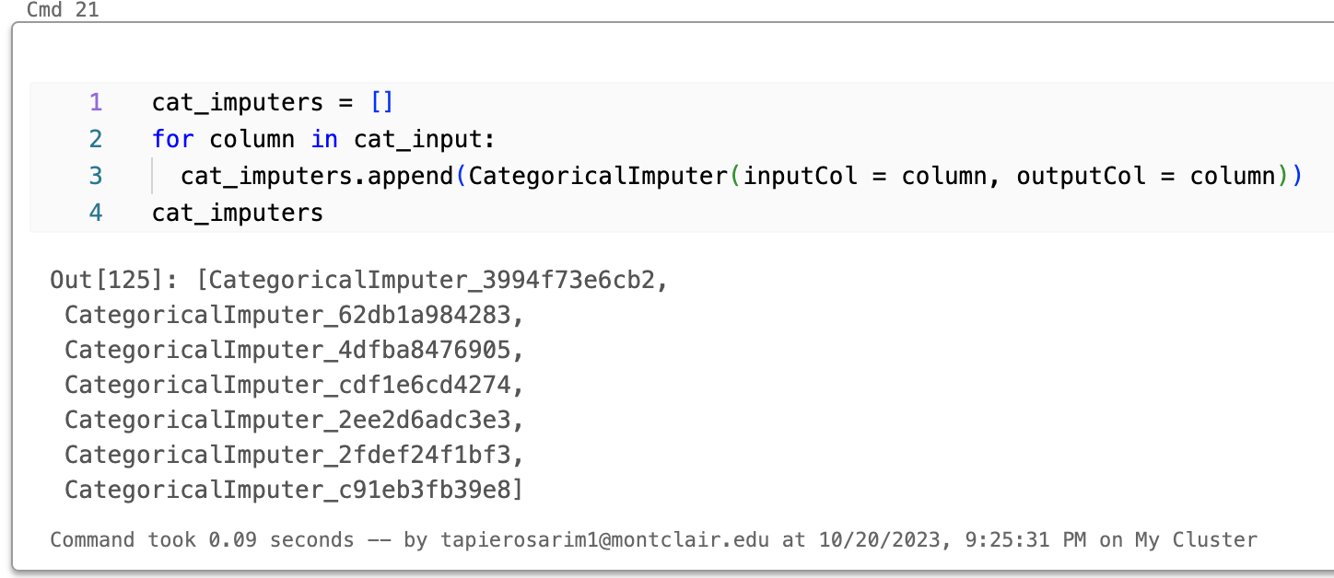
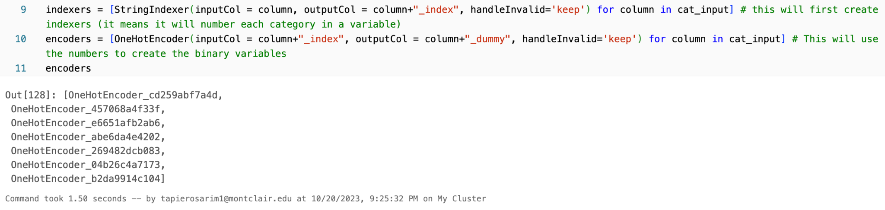
Data PipeLine

Slide 15
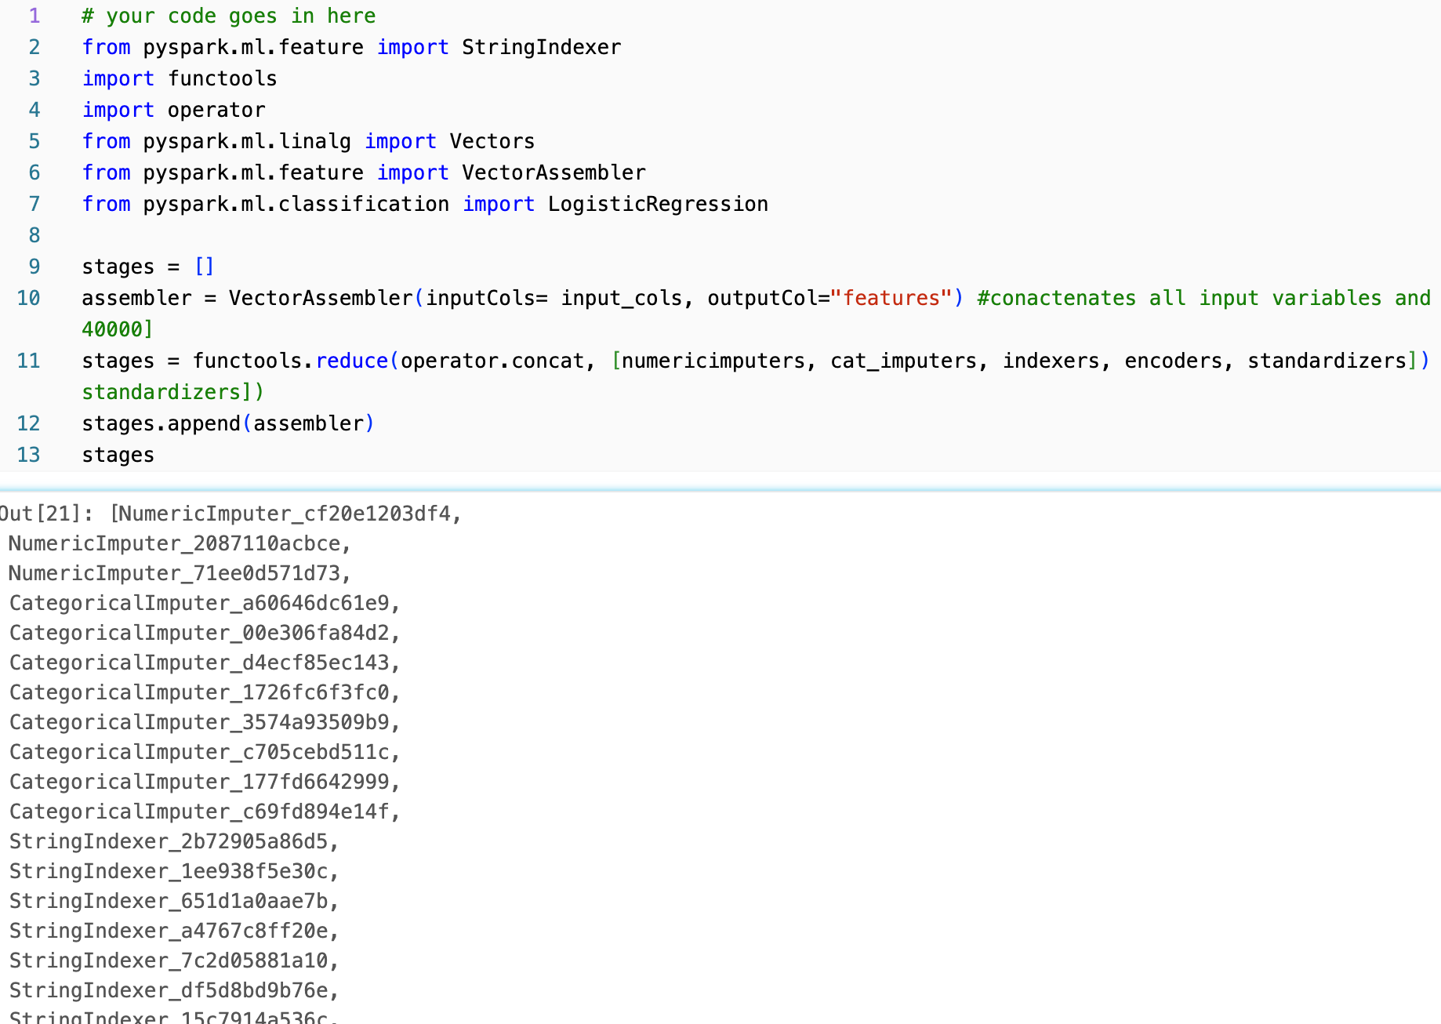
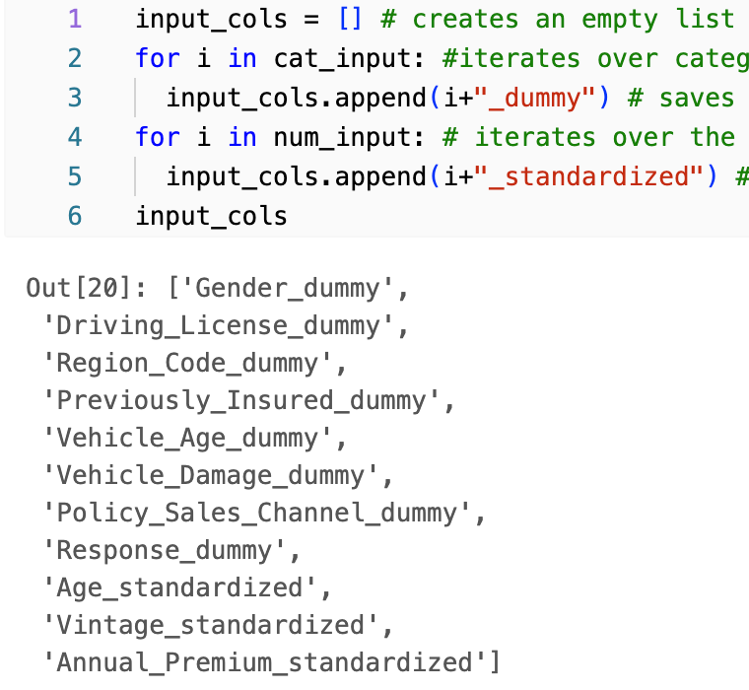
Data PipeLine

Slide 16
K-means
Fit the data in the pipeline
Run the model
Transformed the model
Data that is going to be transformed through the pipeline stages
Get the data that was transformed on the pipeline and run the model to cluster the data.
Find the cluster or assign the cluster for each data point.
1
2
3

Slide 17
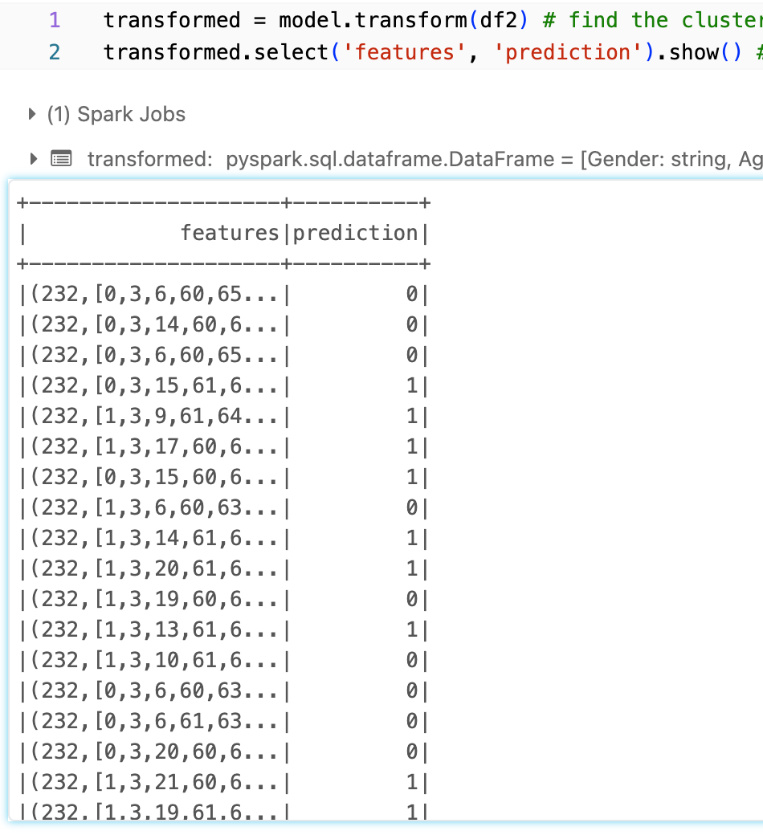
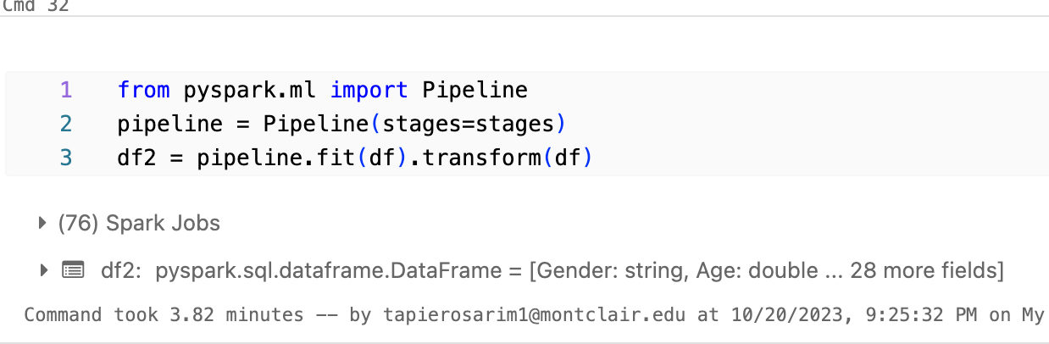
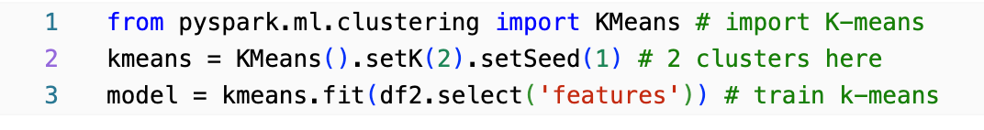
K-means

Slide 18
Findings
max growth
Segments

Slide 19


Graphs
Category Adult- Senior 0 - Age from 41-58
Mean 50
Category 1 Young Adult- I Age from 23-27
Mean 25
Category 1 Young Adult- Customer who are Not interested in a Vehicle Insurance Age from 23-27
Mean 25

Slide 20
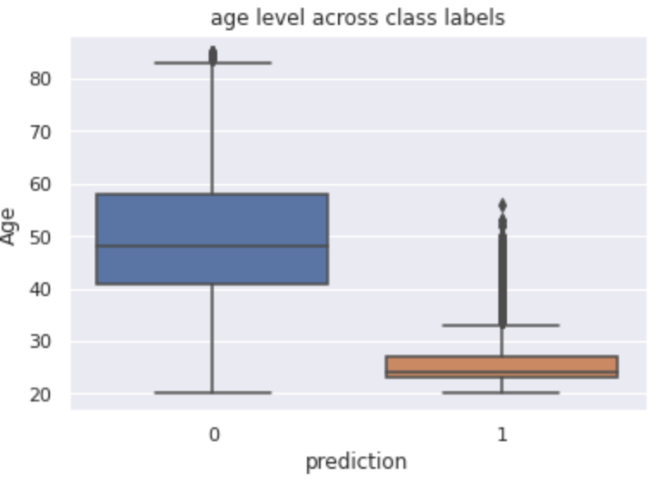
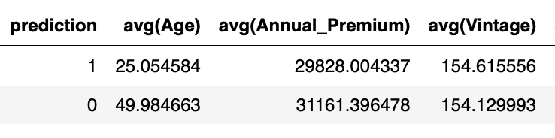
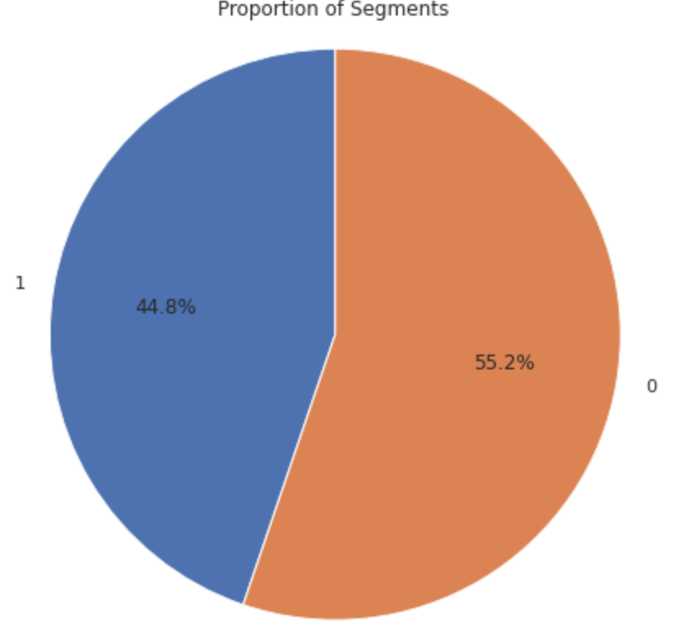
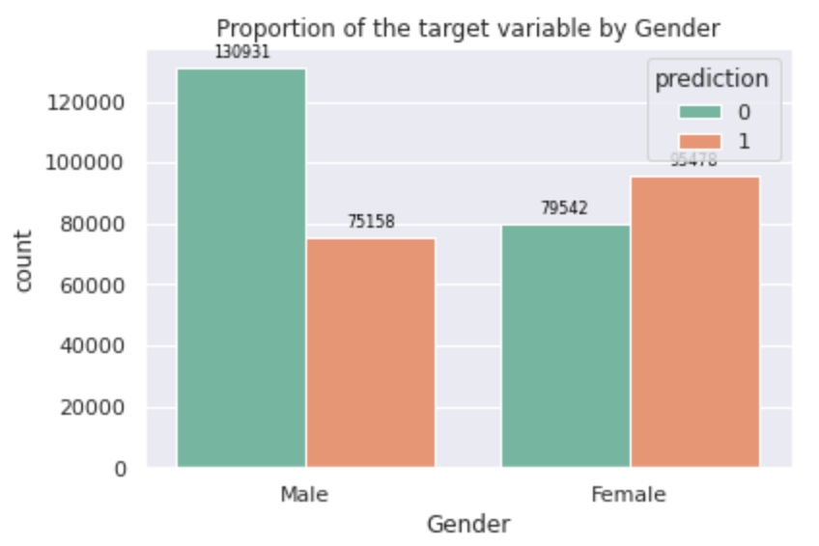
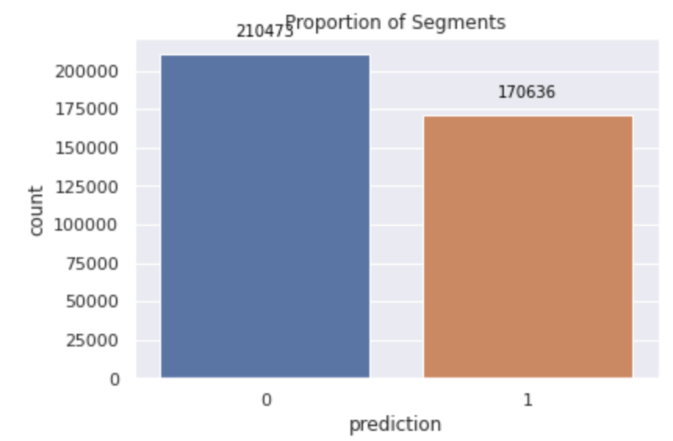
Graphs

Slide 21
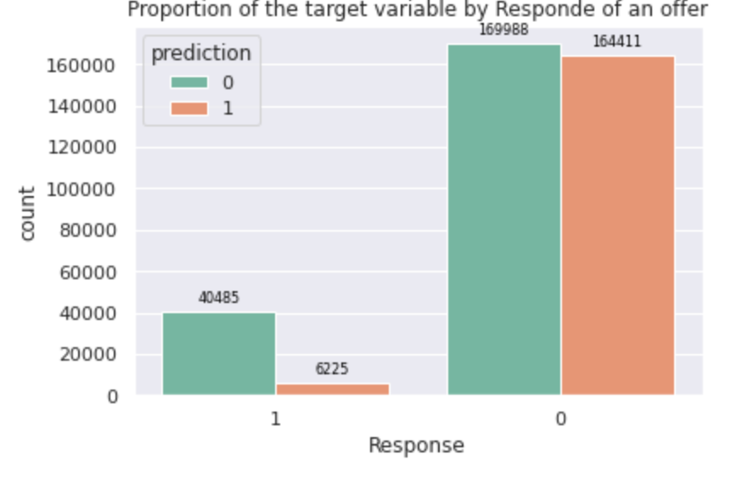
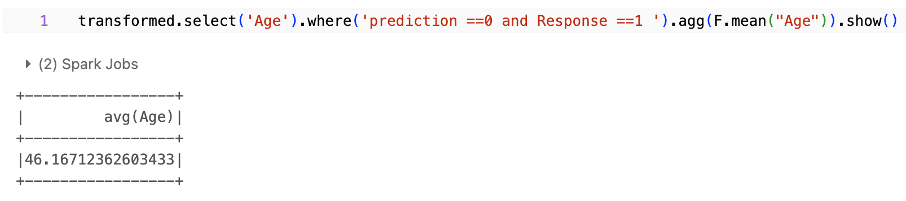
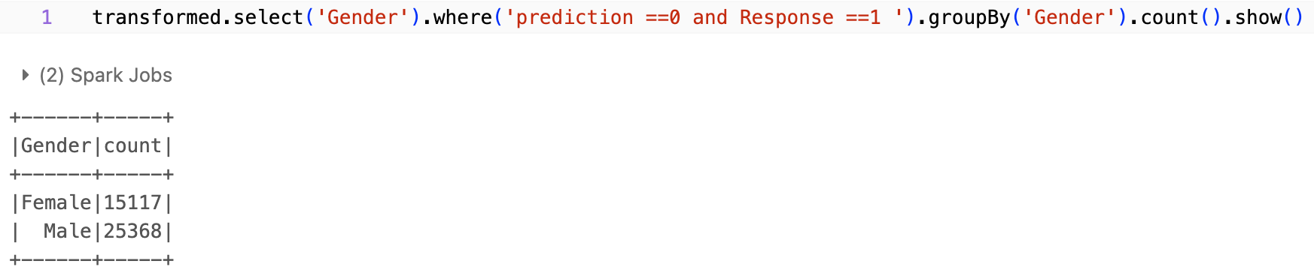
Graphs
Category 1
Category 0

Slide 22
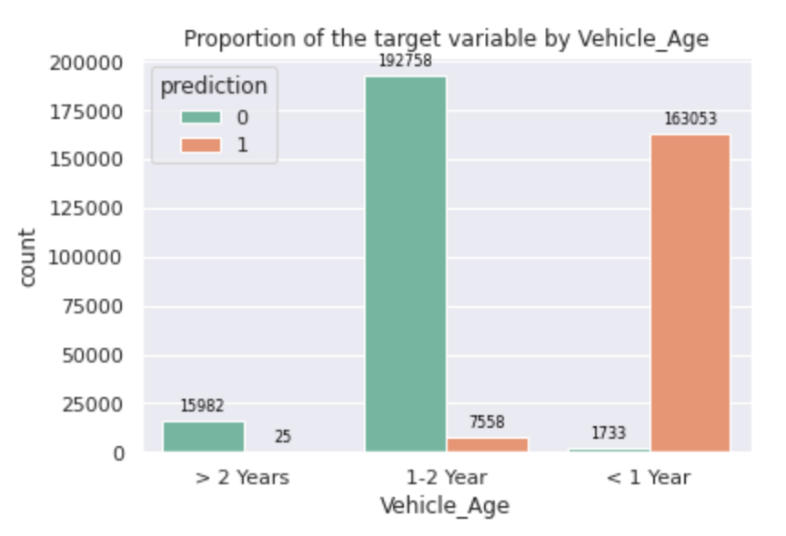
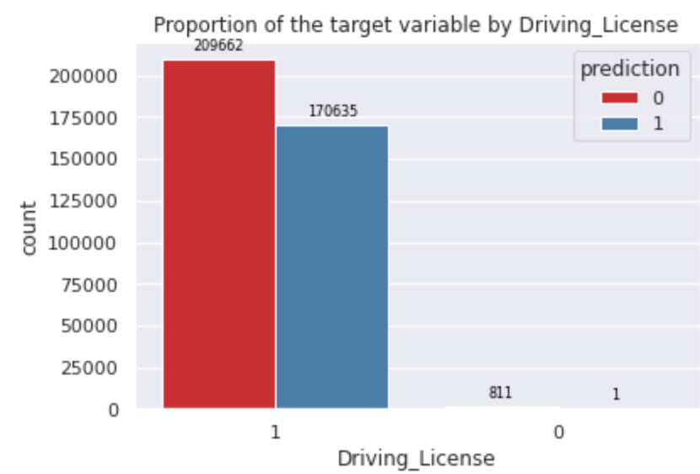
Graphs
Category 1
Category 0

Slide 23
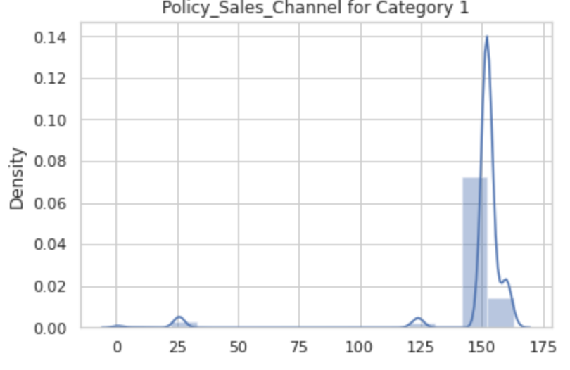
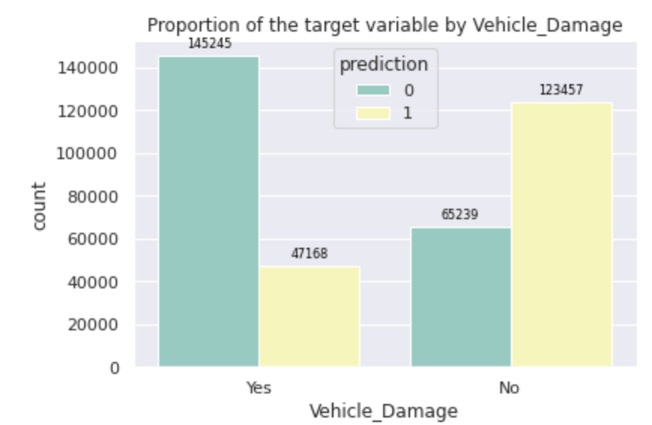
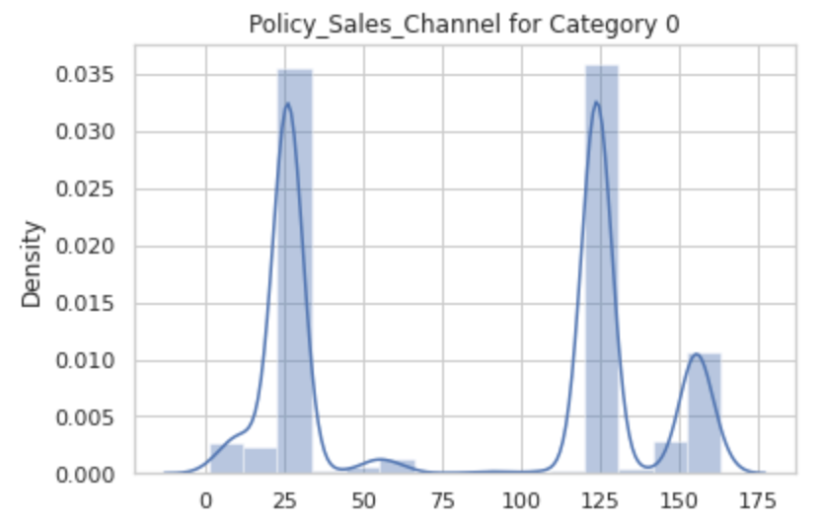
Graphs
Category 1
Category 0

Slide 24
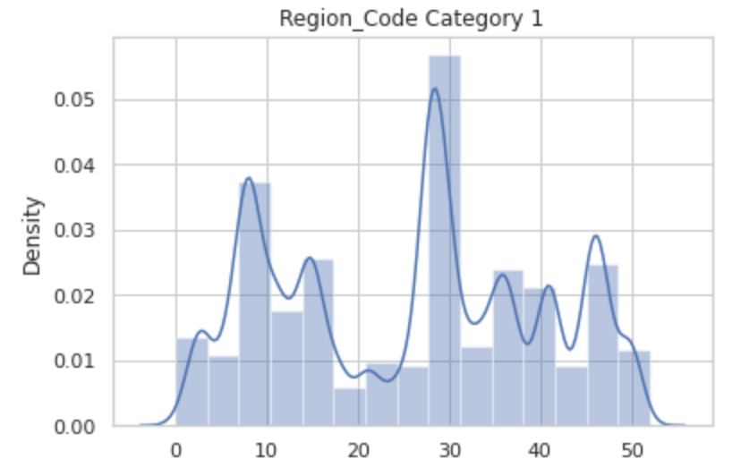
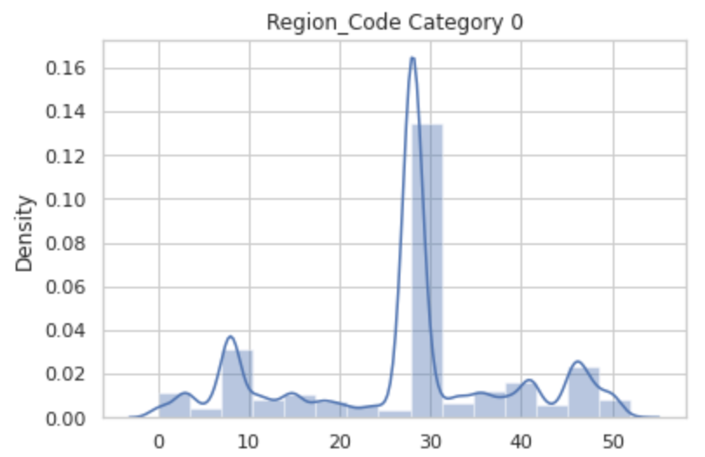
Graphs
Category 1
Category 0

Slide 25
Thank you!

